Slide 1


DevOps Practice
Flairminds
Innovation, Resilience, Efficiency

Slide 2
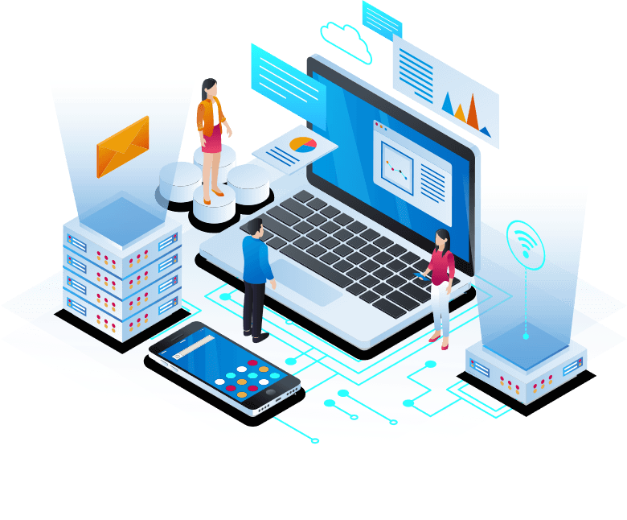
Content
What is DevOps:
Introduction to DevOps
Potential value addition
Flairminds’ approach:
Approach at Flairminds
Tools and technological capabilities at Flairminds
Case studies
Confidential - Work Document

Slide 3
Introduction to DevOps

Slide 4
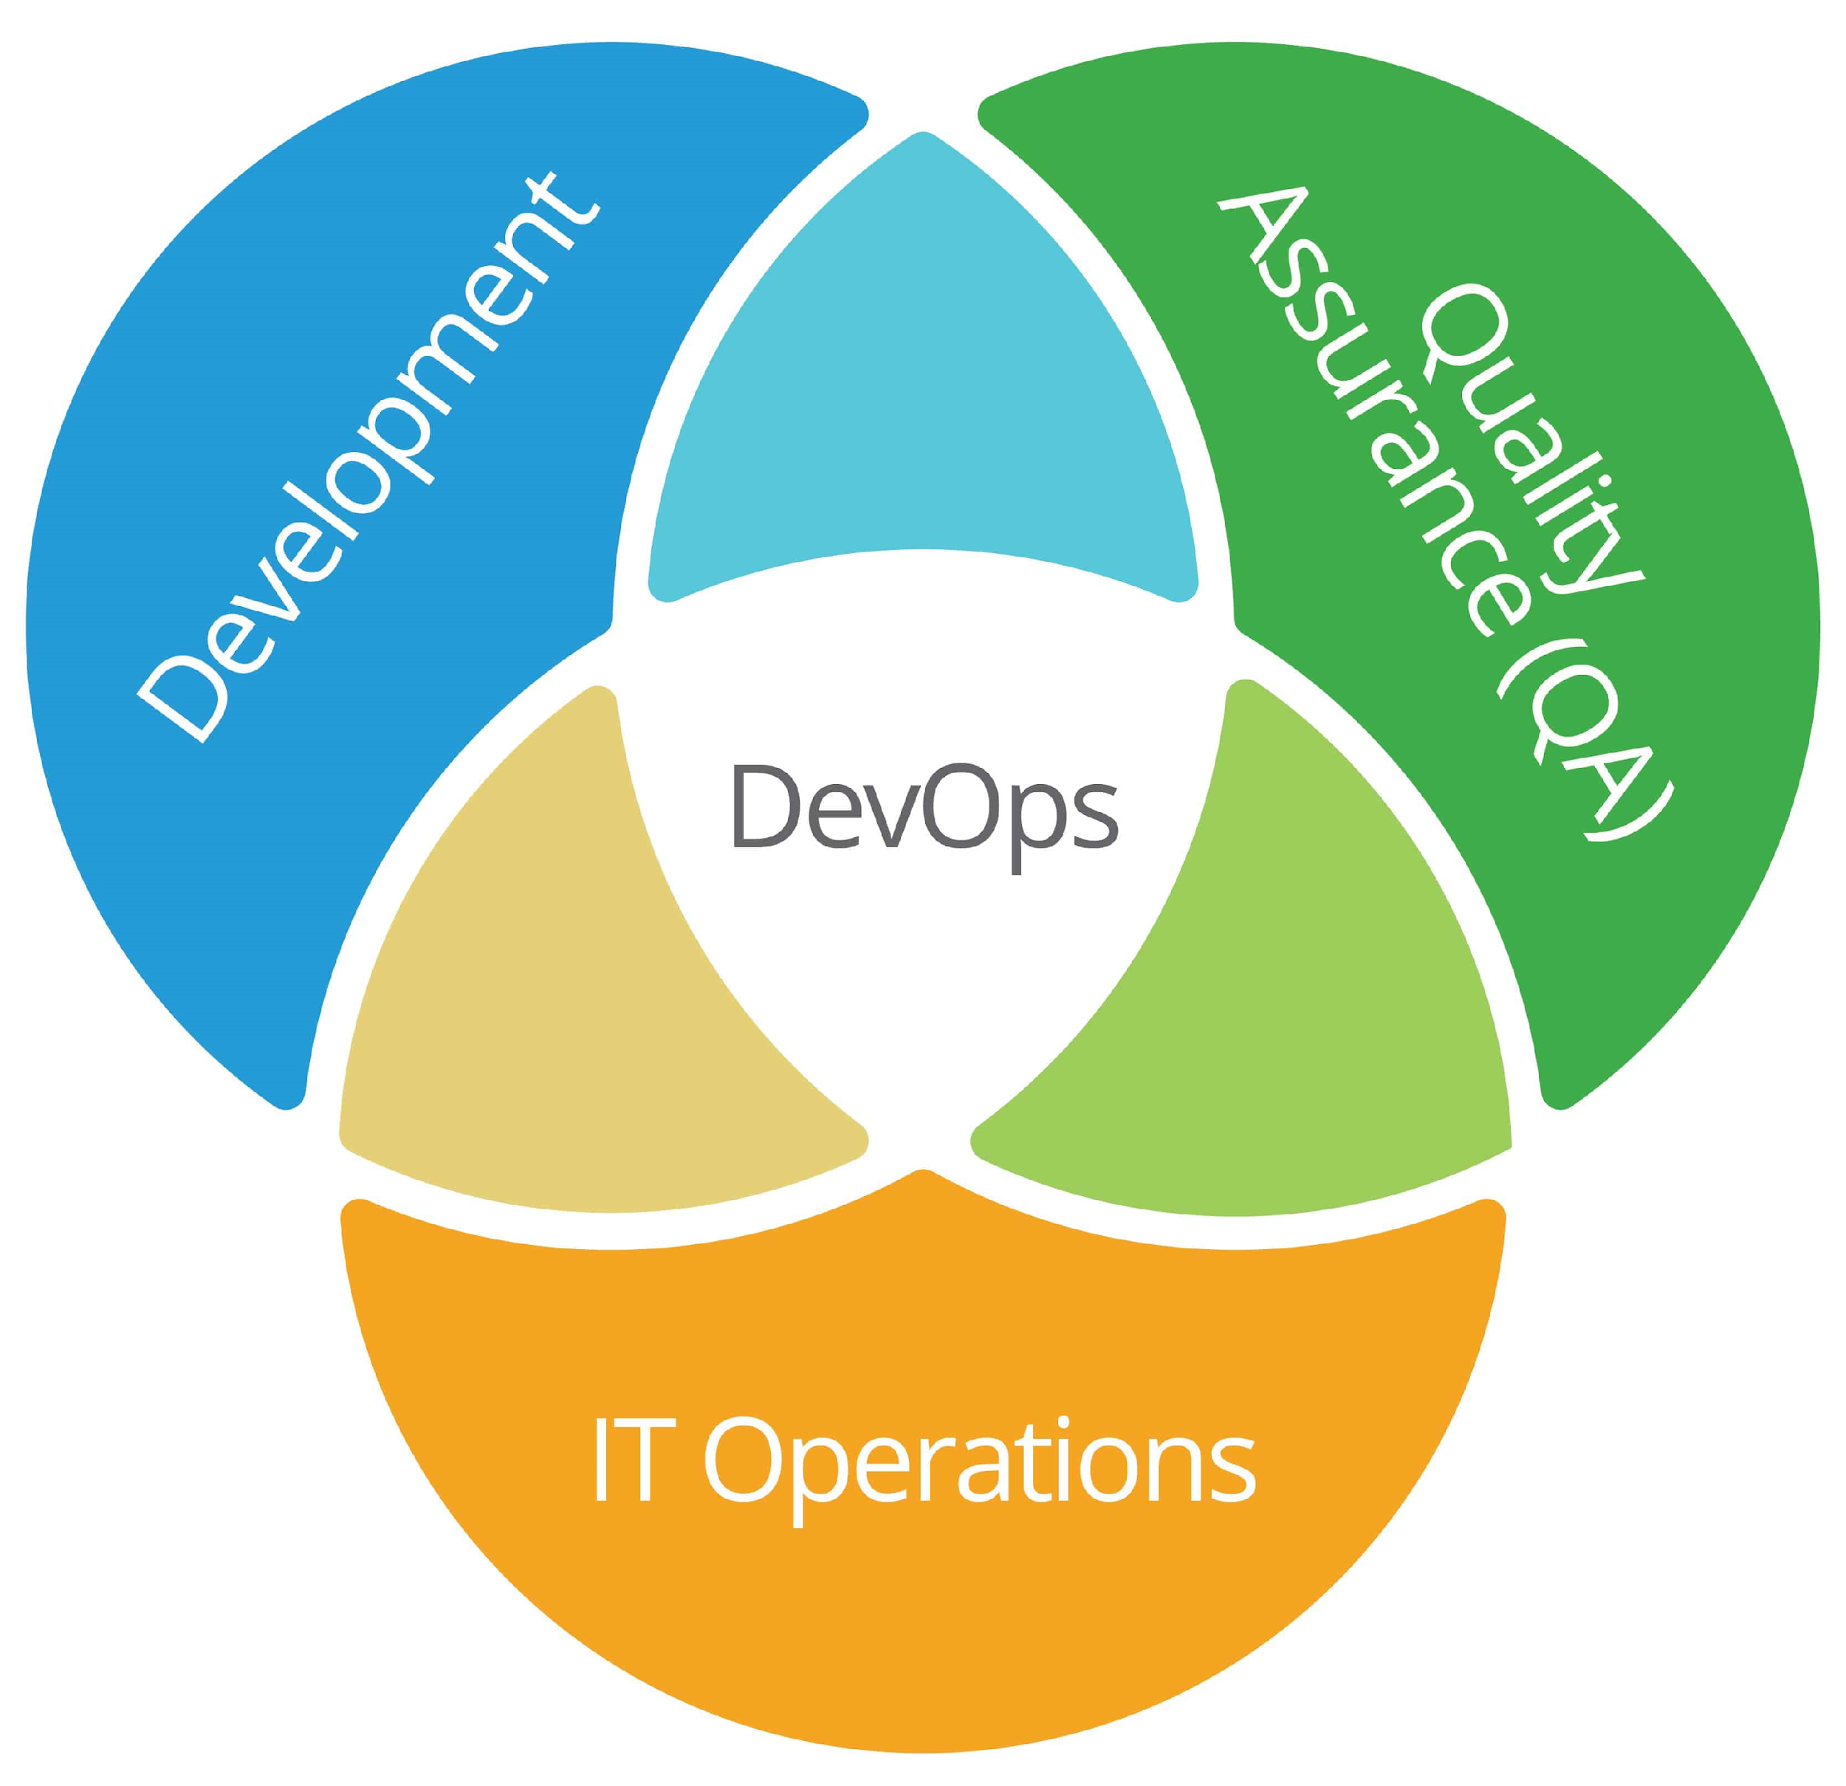
What is DevOps?
DevOps is a software development methodology that improves the collaboration between developers and operations teams using various automation tools. This approach generally helps in building better software faster.
These automation tools are used to create, develop, analyze, integrate and automate various processes and software infrastructures.
The primary objective is to unify and create a lifecycle about continuity and consistency to accelerate the process of app production and ultimately helps businesses to deliver continuous value to their customers.
Examples of this work would be:
Faster development of software
Decreased computation cost and operation time
Less time for integration
Bug reduction benefits of using DevOps
Continuous operation of monitoring, testing, deployment, and release
Confidential - Work Document

Slide 5
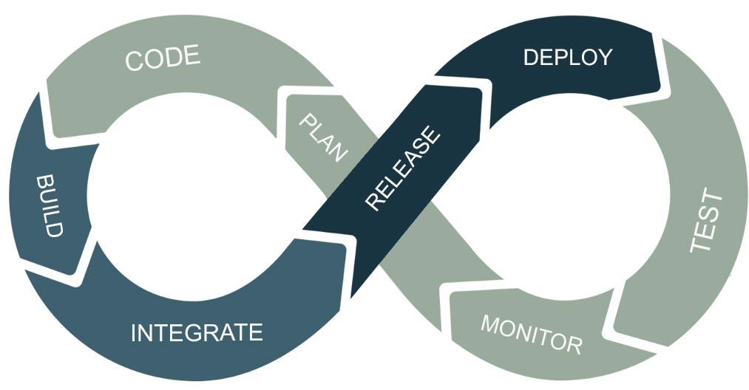
Benefits of using DevOps
DevOps has the potential to add value that can affect the core fundamentals such as development, operations, cost optimization, and security when building an application.
Development:
Infrastructure As Code approach
Creation and automation of development infrastructure
Highly reduced failures and time of implementation
Operations:
Process automation
Higher rate of success for transformation projects and digitalization strategies
Standardization of processes for faster delivery and easier replication
Cost Optimization:
Maximum utilization of investment
Savings on upgrades and maintenance due to increased production efficiency
Security:
Increased security for operations
High overall reliability, availability, and scalability with minimal risk
Confidential - Work Document

Slide 6


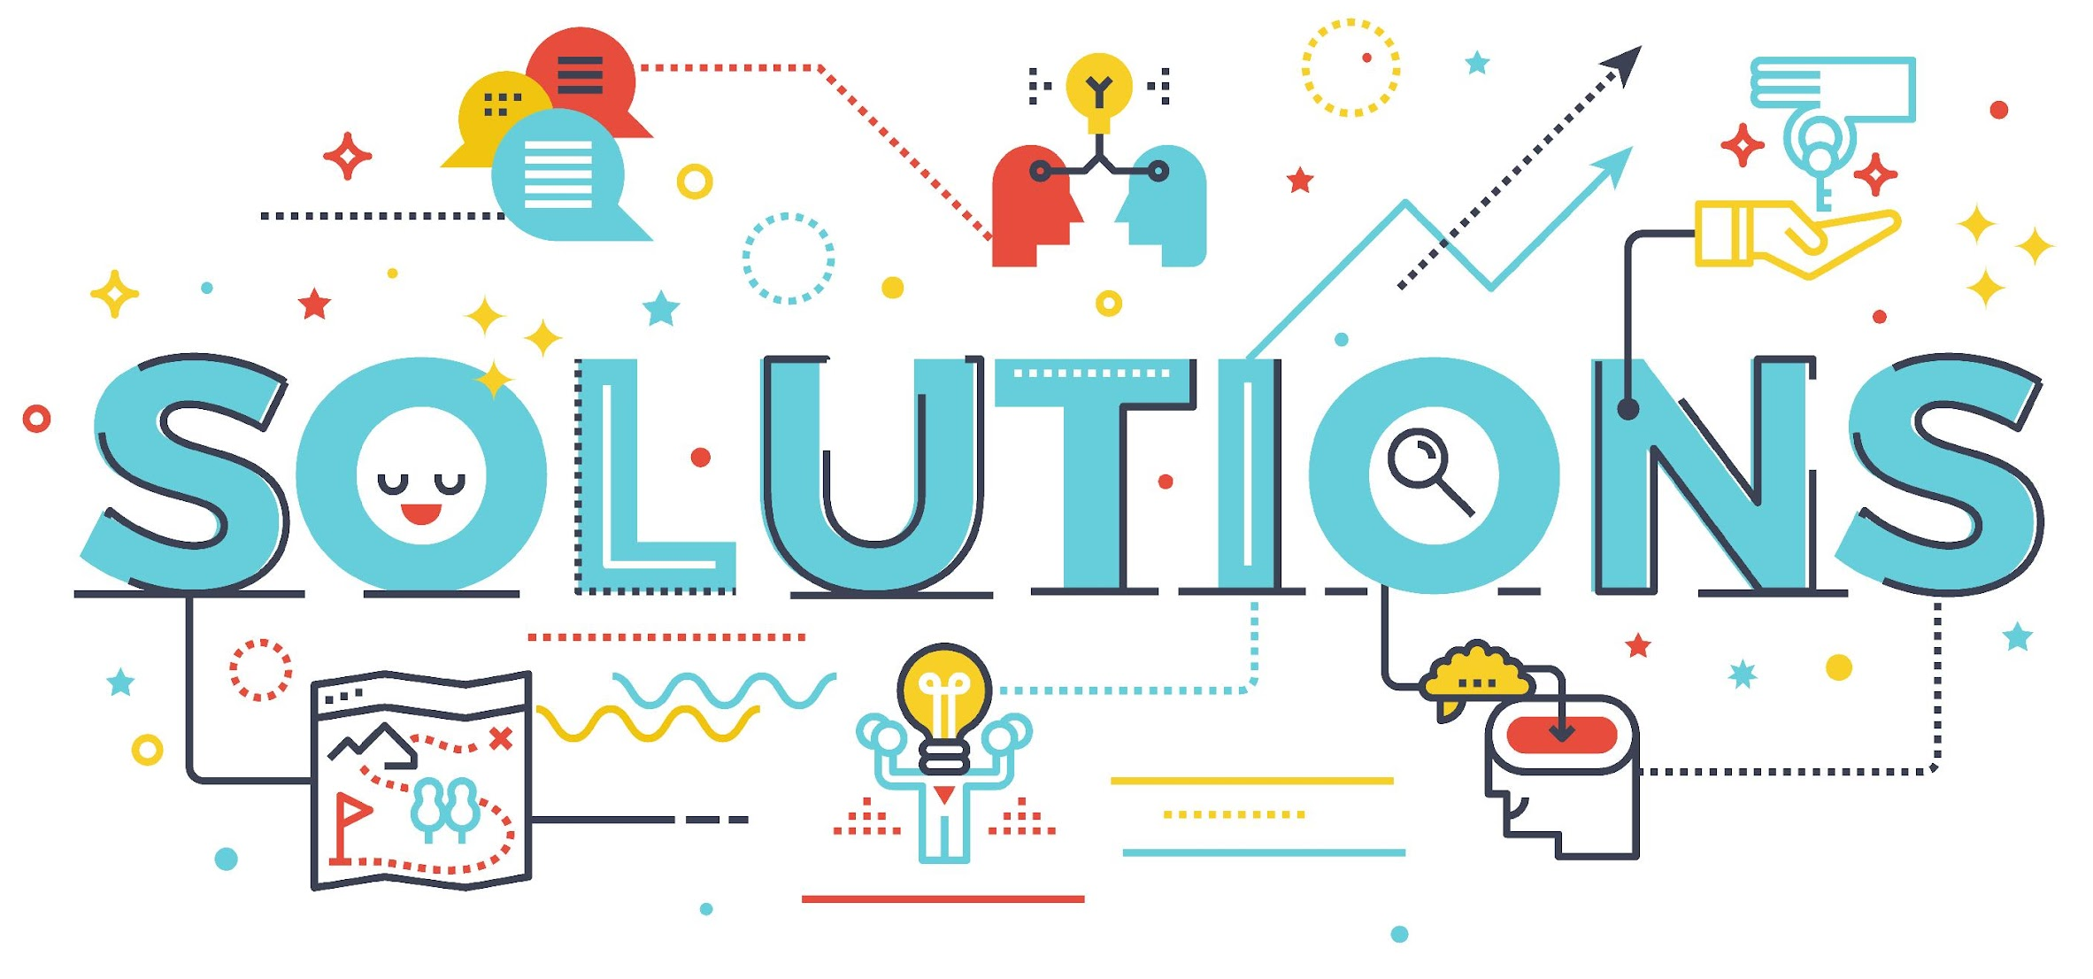
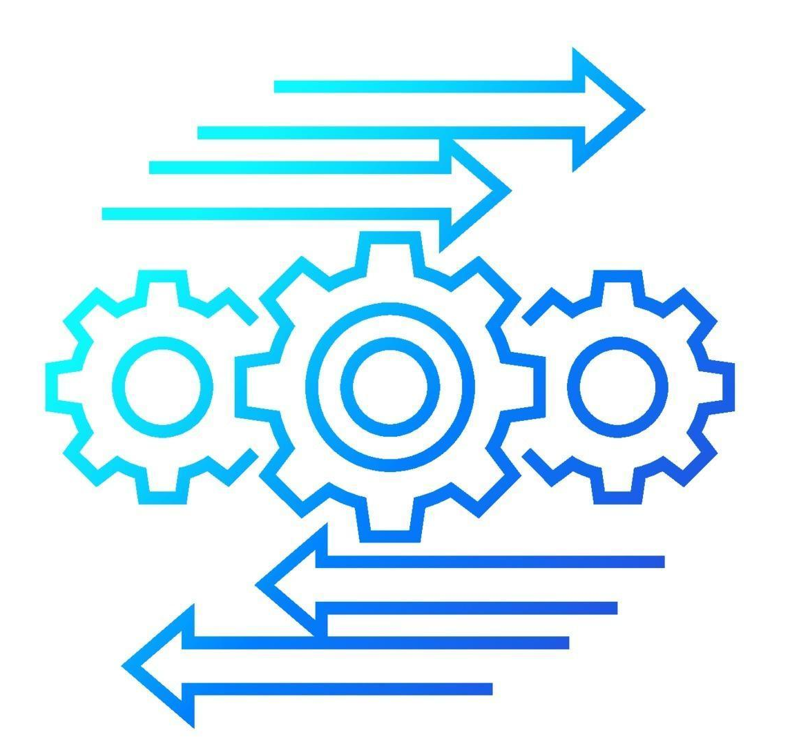
Increasing efficiency across industries
Industries can benefit from using DevOps even if they are not tech-centric.
DevOps approach mainly works on automating and structuring various processes and infrastructures
Different solutions can be implemented in accordance with each industry and in accordance with some specific needs.
Each of these options results in increased throughput in terms of optimization, scalability, decreased costs for production and maintenance, and simplified process automations for decreased errors.
Confidential - Work Document

Slide 7

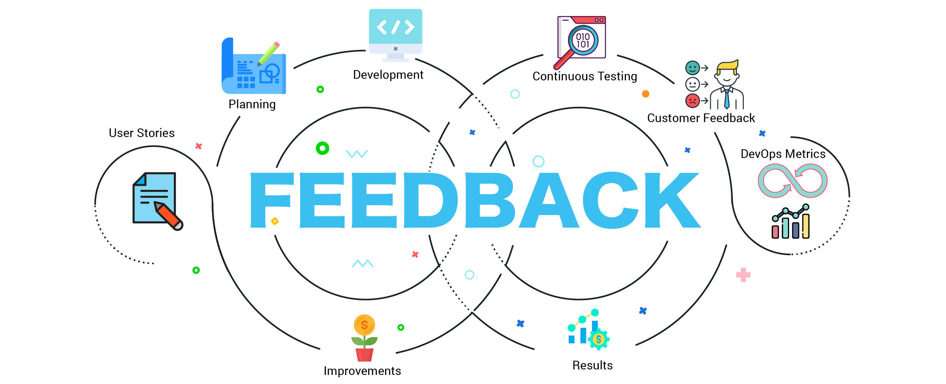
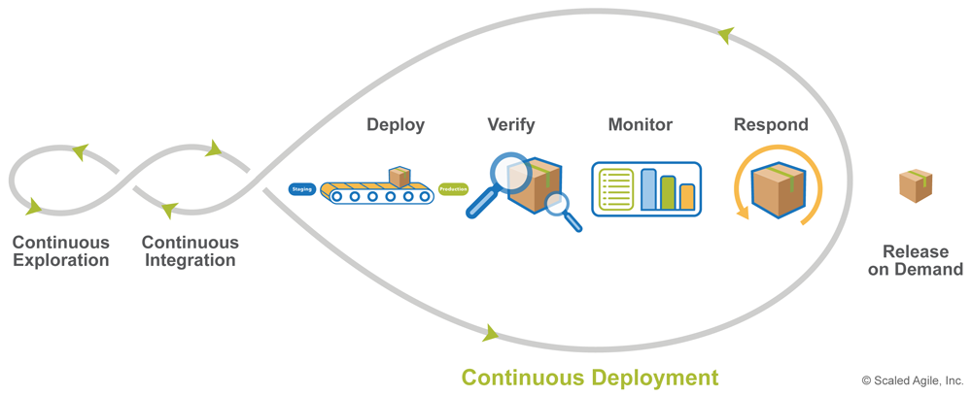
Adhering to best practices
Automated provisioning, automated testing, and automated build and deployment are the foundation of our approach to DevOps architecture.
Additionally, we make sure that virtually everything is logged while maintaining continual feedback and information flow back and forth.
CI/CD best practices are at heart of DevOps Culture, and by implementing those, we make sure that your software remains in a deployable state throughout its lifecycle. It means that you can deploy your system to production on demand at any time.
Confidential - Work Document

Slide 8



Services portfolio@ Flairminds
DevOps CONSULTANCY:
Whether you are creating a new product, or want an expert opinion on your current architecture, we will assist you with industry’s best architects. We will help you set up the infrastructure plan, which will reduce complexity and cost, while delivering robust and quality.
COST Optimization:
Worried about huge bills? We are there to help. We bring best practices from FinOps to help you identify idle resources, reduce data transfer costs, and also recommend you architecture changes that will help you run your product with minimal cost.
CLOUD SERVICES:
Serverless:
Cloud services work best, when you can leverage the serverless services offered by your cloud vendor. This reduces your cost of maintaining a huge codebase, maintaining and monitoring the infrastructure. You also get up to date software updates, security updates, so that you and your developers focus on the best you do, Build Your Product.
Cloud Native consultancy:
Modernize your application architecture by leveraging best offerings from CNCF. We help you build, migrate and maintain your product architecture on the cloud.
Cloud Migration:
Whether moving from on-prem to cloud, or moving from one cloud to another, we help you in a smooth transition, with almost no downtime.
CI/CD:
Automated pipelines that continuously build, test, integrate and deploy to various environments is the baseline on which companies thrive. We help you build your pipelines, maintain and monitor, and also keep them up to date with the latest industry best practices.
INFRASTRUCUTRE:
Monitoring:
Having trouble keeping your production environment stable? We help you proactively monitor your infrastructure, logs, metrics, to help you solve infrastructure as well as code issues quickly.
Infrastructure as Code:
Are you manually provisioning your infrastructure? Do you have trouble identifying resources which were created long ago by ex-employee? We help you migrate your infrastructure to IaC. This helps you not only document all your resources in a SCM, but also ensures that nobody changes the infrastructure manually.
Confidential - Work Document

Slide 9
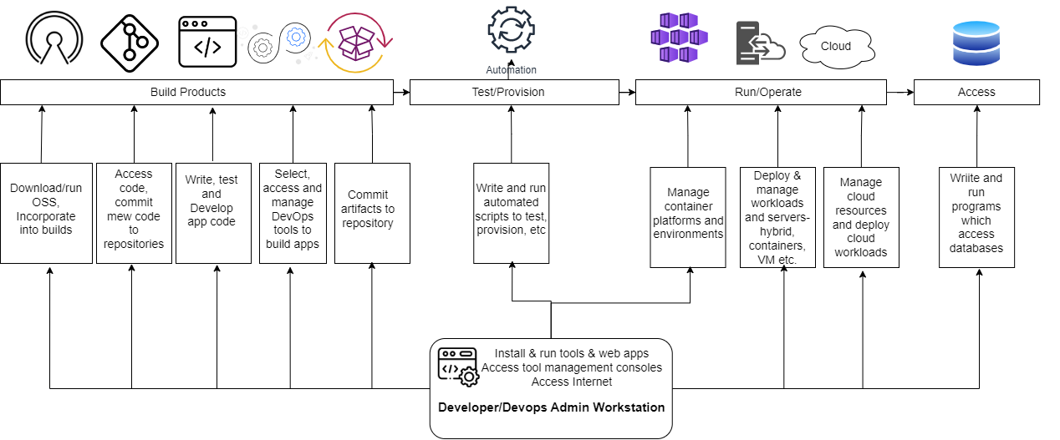
Approach@Flairminds
Although the workflow changes as per specific requirements, this is a generalized form of DevOps approach followed for various cloud providers
Confidential - Work Document

Slide 10
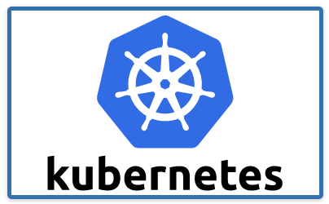
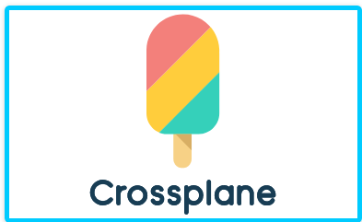

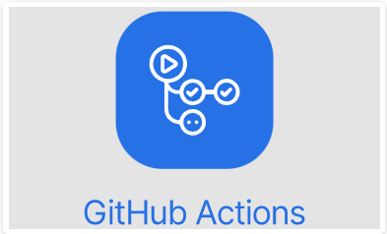
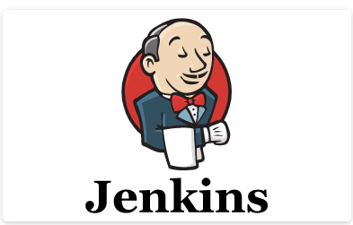
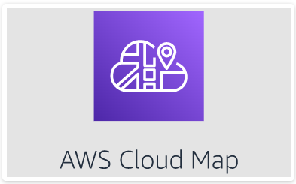
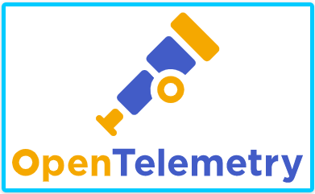
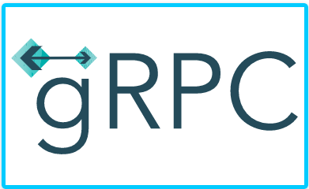

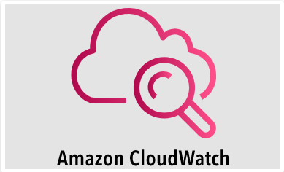
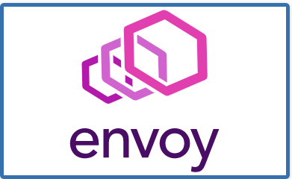
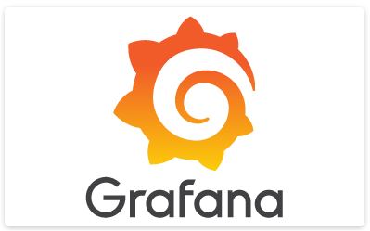
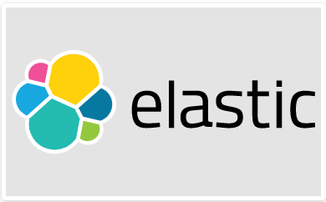
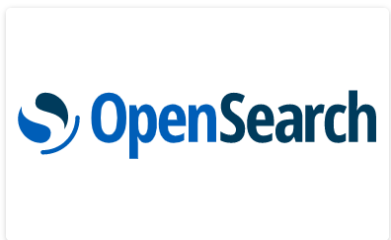

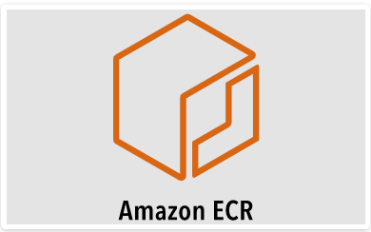
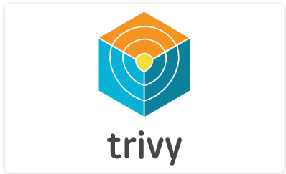
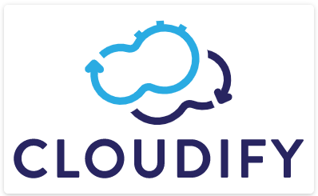
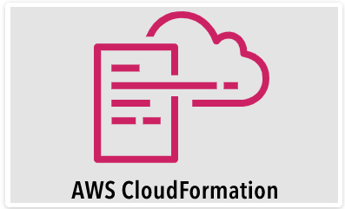
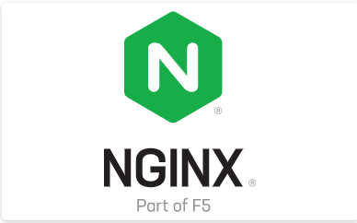
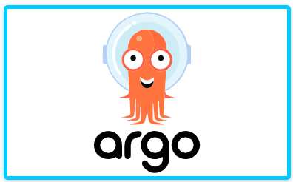
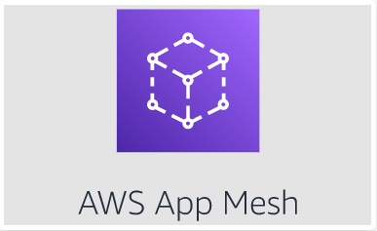
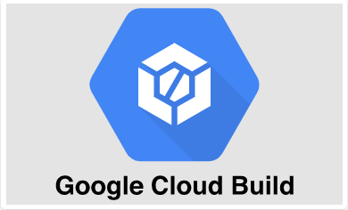
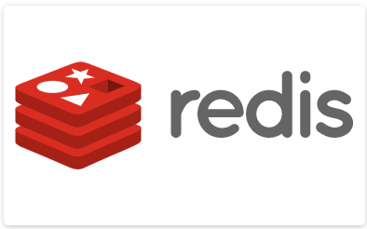
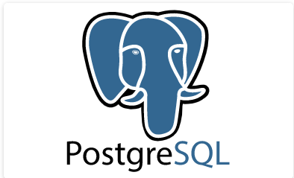
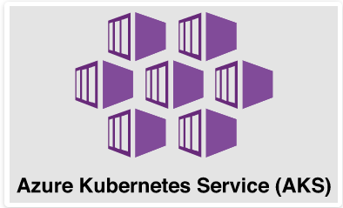
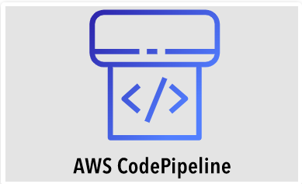
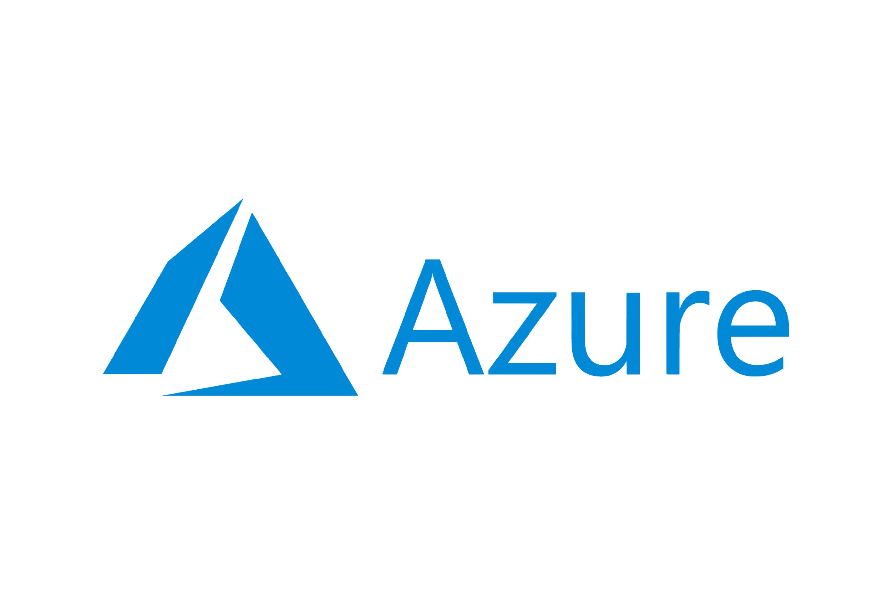
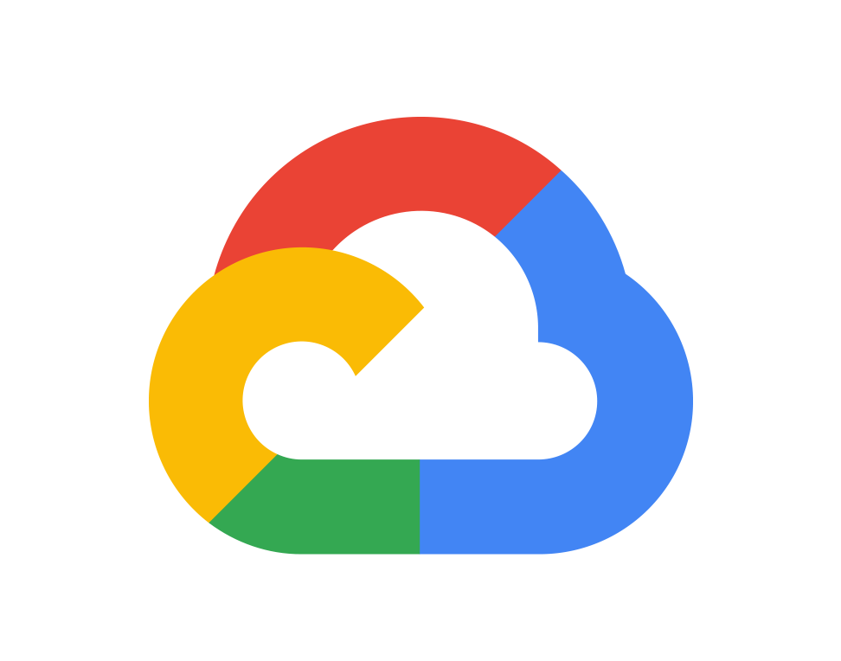
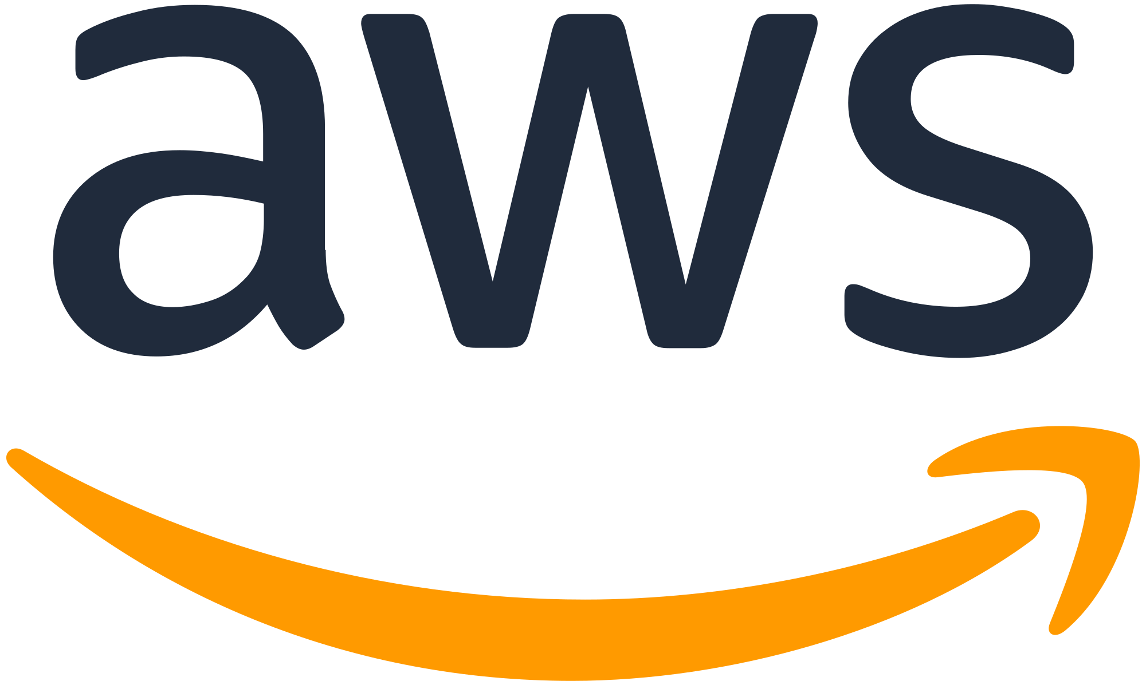
Data ecosystem & services @ Flairminds
Ecosystem:
Services:
DevOps Engineer
Cloud Architect
DevSecOps
Infrastructure Modernization
Deployment automation and orchestration
Code Inspection & Integration
Configuration Management and Optimization
PLATFORMS
Confidential - Work Document

Slide 11
Case studies

Slide 12
Case Study A AI-ML medical IT products company
INTRODUCTION:
Customer: Medical IT product company, focused on AI-ML based solutions for disease prediction and management.
It’s Disease Prediction Solutions serve over 2.5 million patients, helps physicians in clinical decision-making and early disease identification while reducing risk and saving lives.
Enhance illness prediction system and create a state-of-the-art conceptual cloud infrastructure in preparation for the launch of a newer, enhanced prediction system that will subsequently be utilized for disease analysis.
OBJECTIVE
Convert the existing architecture to a cloud-based one, FM used a CI/CD-managed cloud architecture with several servers, databases, and analytical engines divided across development phases for the initial version.
SOLUTION
BENEFITS:
Improved ability to onboard a large number of clients due to the added benefit of using the cloud and expanding their business as the solution allowed migration of their prior system architecture to the cloud providing them more flexibility.
Confidential - Work Document

Slide 13
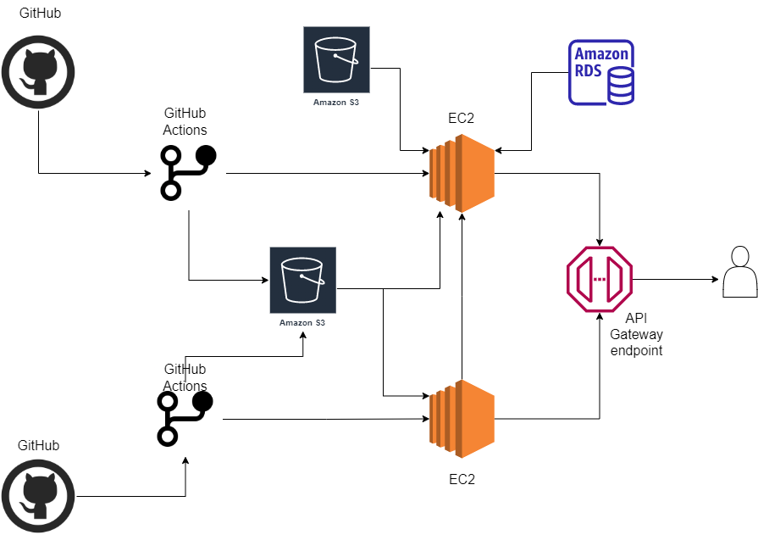
Case study A AI-ML medical IT products company Contd.
ARCHITECTURE:
Confidential - Work Document

Slide 14
Case study B Retail IT Software company
INTRODUCTION:
Customer: Multinational software provider enabling omnichannel retailing with annual revenue of USD 14mil.
They assist businesses and merchants in reaching and gratifying clients worldwide through a variety of channels.
Microservices architecture SaaS product is being launched. Plan is to deploy the product on AWS cloud. FM has been engaged to create the overall cloud architecture.
OBJECTIVE
Cloud architecture that is fully automated, cross-region scalable , adaptable and highly secure; built with IaC (Infrastructure as Code) along with drift detection to stop infrastructure tampering.
SOLUTION
Confidential - Work Document

Slide 15
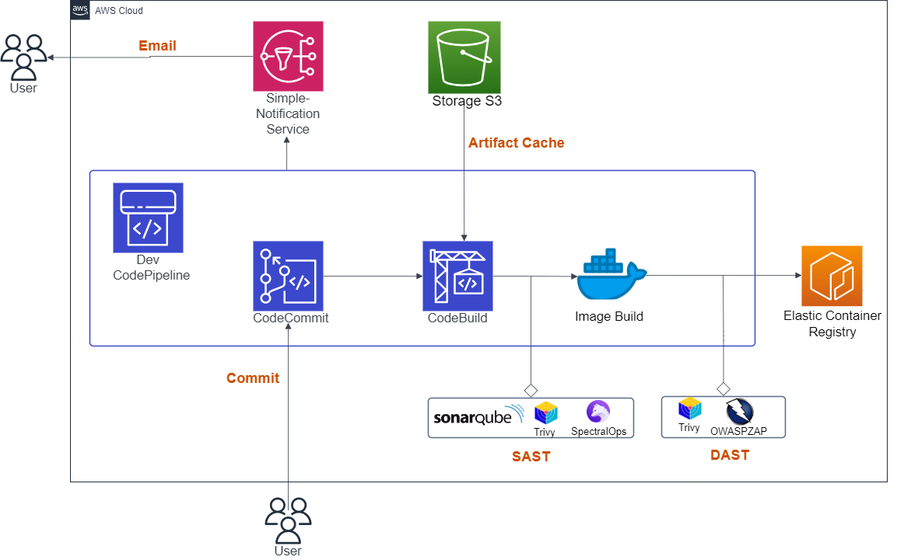
Case study B Retail IT Software company Contd.
ARCHITECTURE: Part 1
Confidential - Work Document

Slide 16
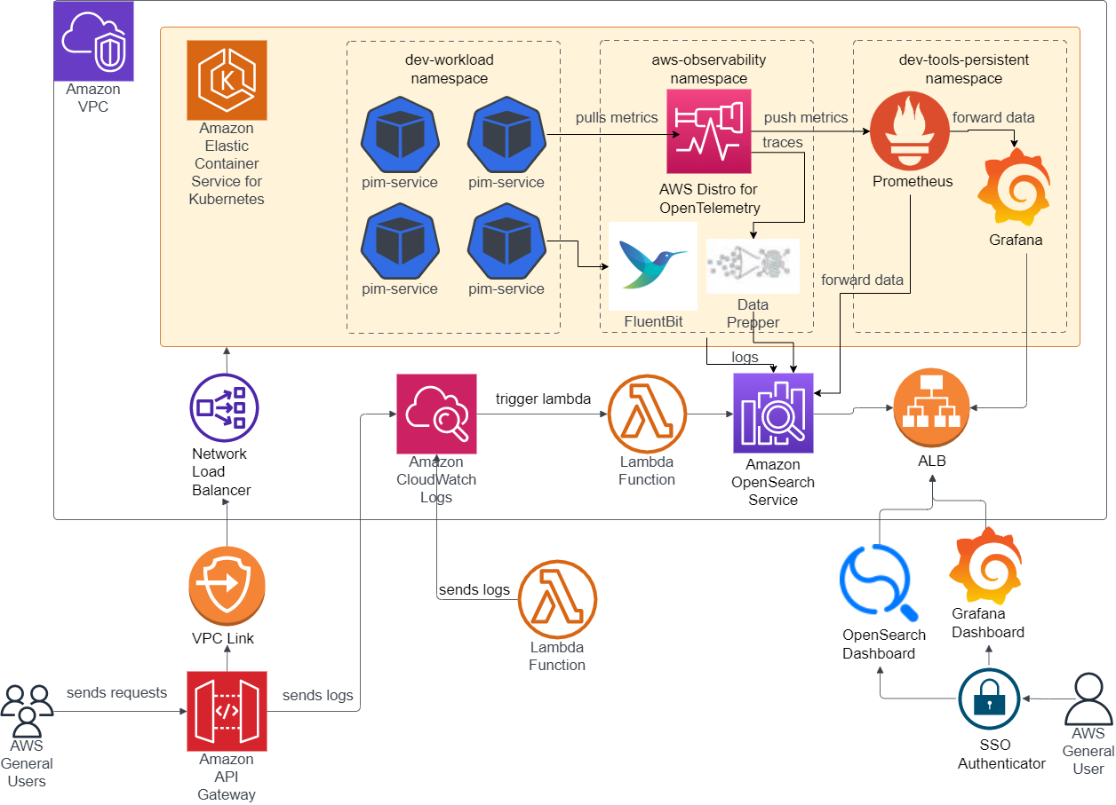
Case study B Retail IT Software company Contd.
ARCHITECTURE: Part 2
Confidential - Work Document

Slide 17
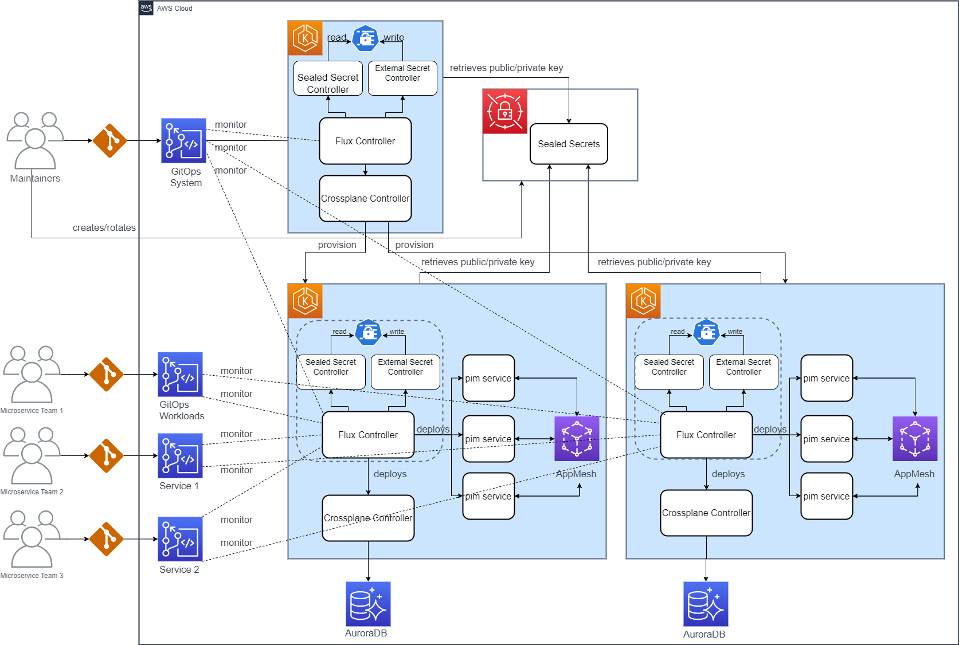
Case study B Retail IT Software company Contd.
ARCHITECTURE: Part 3
Confidential - Work Document

Slide 18
Case study C Leading DevOps automation company
INTRODUCTION:
Customer: IT products company providing environment as a service through infrastructure automation products.
Product: Open source, multi-cloud orchestration platform that turns all the public and private infrastructure into environments that can automate DevOps operations and governance processes.
Flairminds was required to provide tunnel as a service for CloudifyTests platform. The service running on a local system should be accessible inside CloudifyTests cluster for running automated tests on those services.
OBJECTIVE
Developed a product with which customer’s users can access the services inside CloudifyTests cluster which are running on user's system to run automated tests on those services.
SOLUTION
Confidential - Work Document

Slide 19



Case study C Leading DevOps automation company Contd.
BENEFITS TO CUSTOMER:
Load Balancing - A popular website that gets millions of users every day may not be able to handle all of its incoming site traffic with a single origin server. Instead, the site can be distributed among a pool of different servers, all handling requests for the same site. In this case, a reverse proxy can provide a load balancing solution which will distribute the incoming traffic evenly among the different servers to prevent any single server from becoming overloaded.
Protection from attacks - With a reverse proxy in place, a web site or service never needs to reveal the IP address of their origin server(s). This makes it much harder for attackers to leverage a targeted attack against them, such as a DDos Attack.
SSL encryption - Encrypting and decrypting SSL (or TSL) communications for each client can be computationally expensive for an origin server. A reverse proxy can be configured to decrypt all incoming requests and encrypt all outgoing responses, freeing up valuable resources on the origin server.
Caching - A reverse proxy can also cache content, resulting in faster performance.
Confidential - Work Document

Slide 20
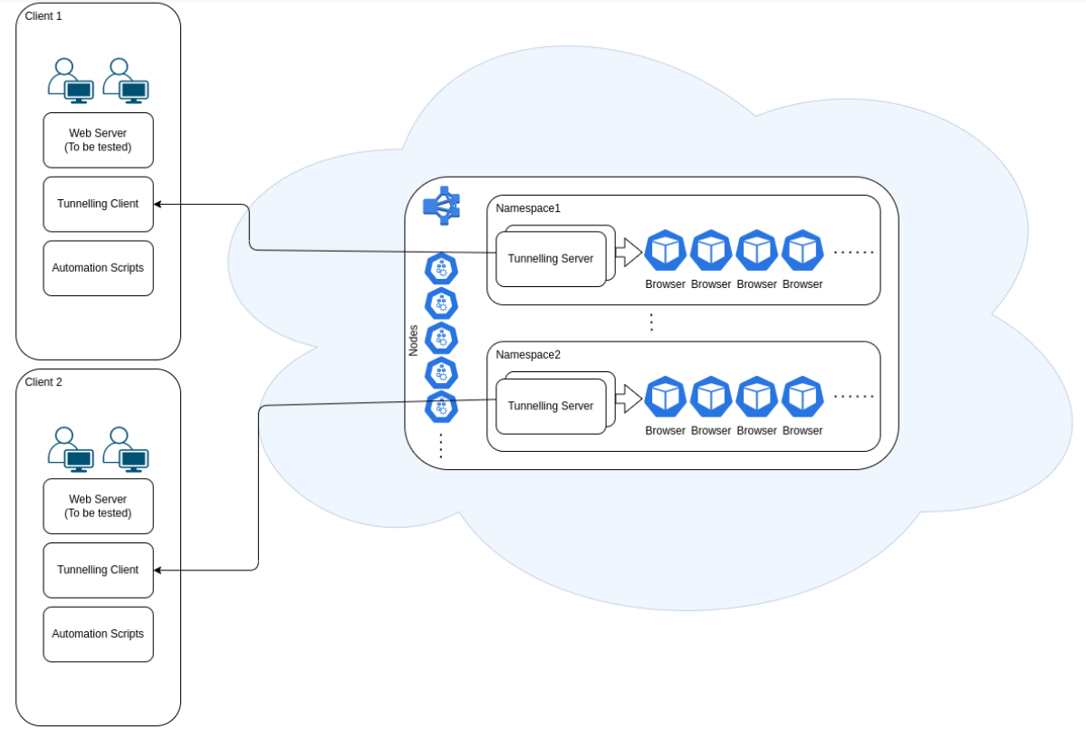
Case study C Leading DevOps automation company Contd.
ARCHITECTURE:
Confidential - Work Document

Slide 21




Contact
PUNE OFFICE
FlairMinds Software Pvt. Ltd. 11, Soormani, 163 D.P.Road, Aundh, Pune, opposite DAV School, 411007, India
NAGPUR OFFICE
Infosane Technologies llp Nagpur, Shop No. 168, RAJAT SANKUL Opp. S.T. Stand, Near Hotel Rahul Deluxe GANESH PETH, Nagpur, Maharashtra 441108,India
sales@flairminds.com
+91 9967 650 472
FlairMinds
Confidential - Work Document

